Slide 1

G2M Case Study
Cab Investment Firm
20.10.2022

Slide 2
Case Summary
XYZ is a private equity firm in US. Due to remarkable growth in the Cab Industry in last few years and multiple key players in the market, it is planning for an investment in Cab industry.
Objective: Provide actionable insights to help XYZ firm in identifying the right company for making investment.
The analysis will provide information about the following:
Data Understanding
Forecasting profit and number of rides for each cab type
Finding the most profitable Cab company
Recommendations for investment

Slide 3
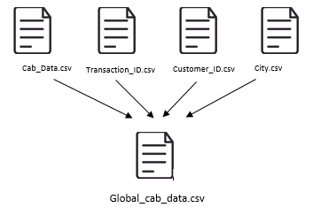
Data Exploration
4 different data sets were combined into one
Timeframe of the data: 2016-01-31 to 2018-12-31
Total data points : 359,392
There are 18 features in total and 6 of them are derived.
Age and income features were divided into subcategories.
Profit of rides were calculated using price charged and cost of trip features, also if the ride was profitable or not was calculated this way.

Slide 4
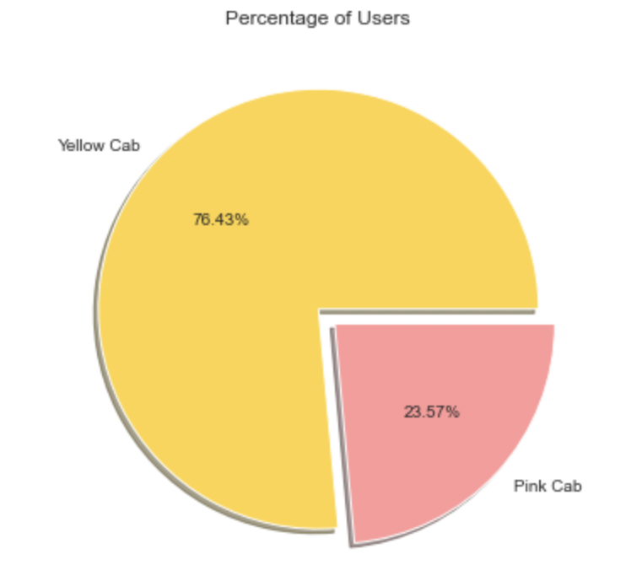
User Distribution
Yellow Cab company has the majority of users with nearly 77%.

Slide 5
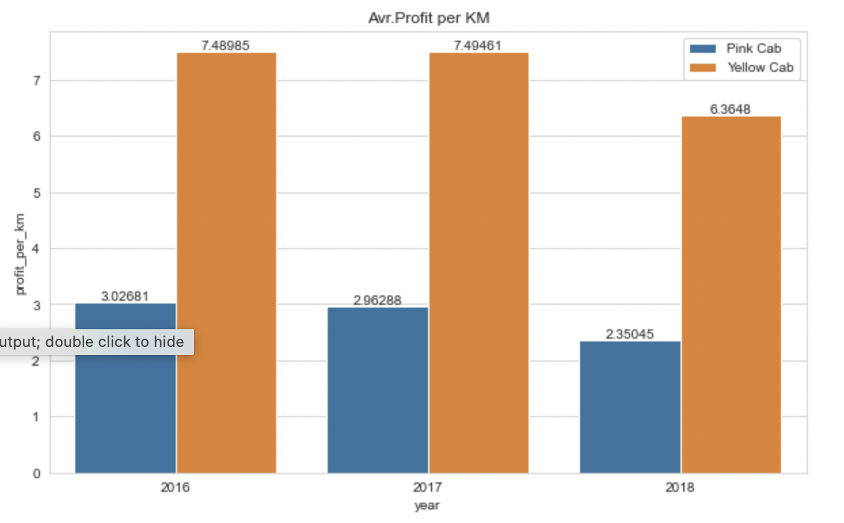
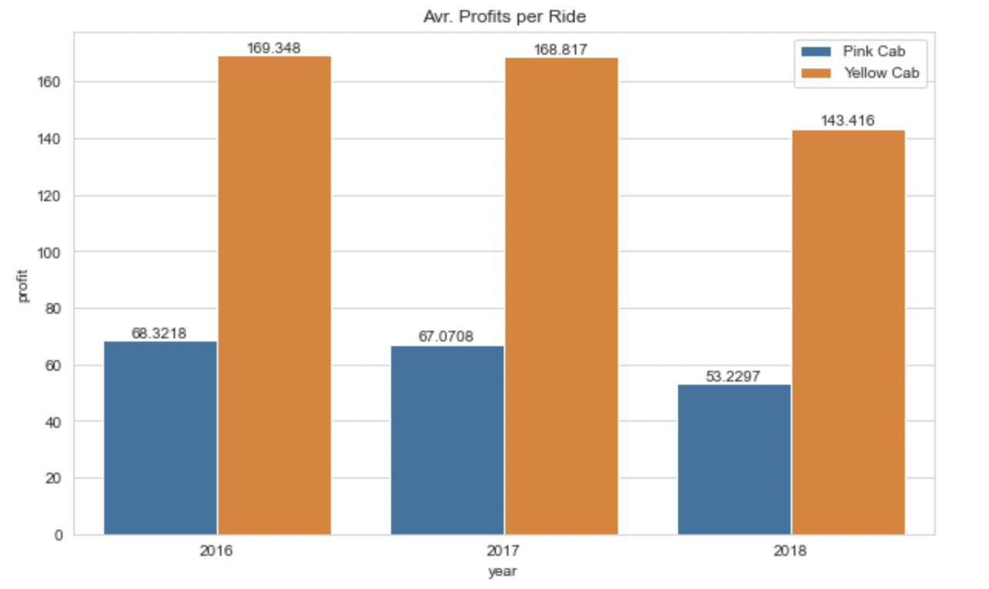
Profit Analysis per Ride and KM
Yellow cab has more profit per ride and km for every year.

Slide 6
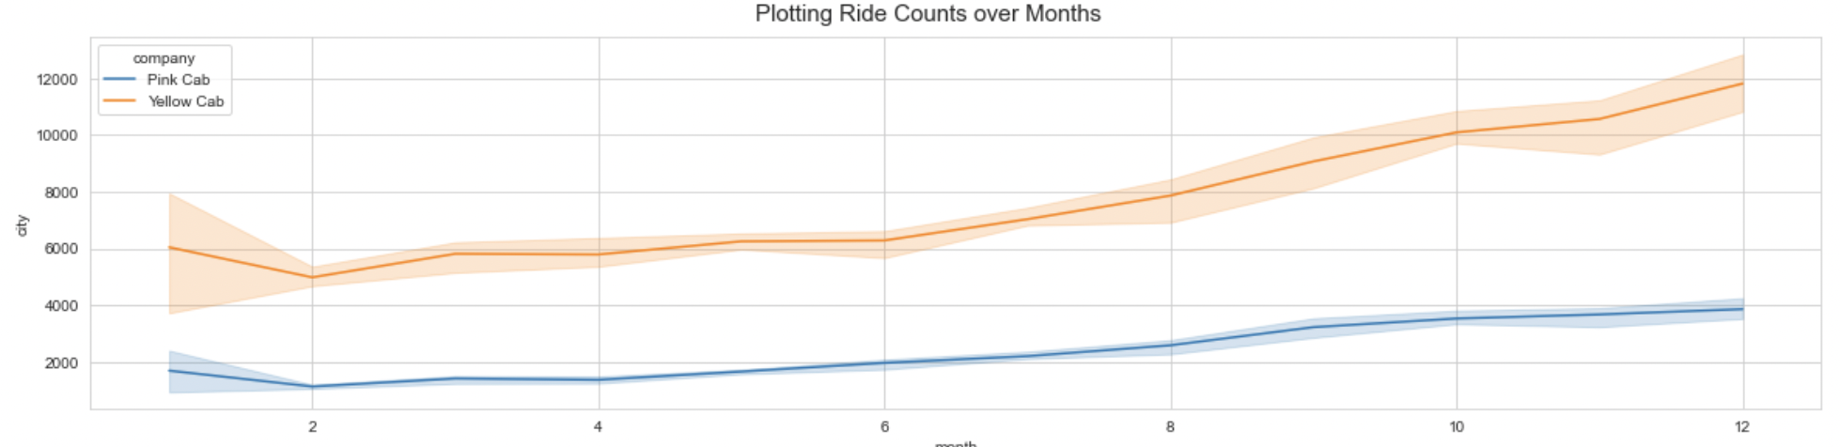
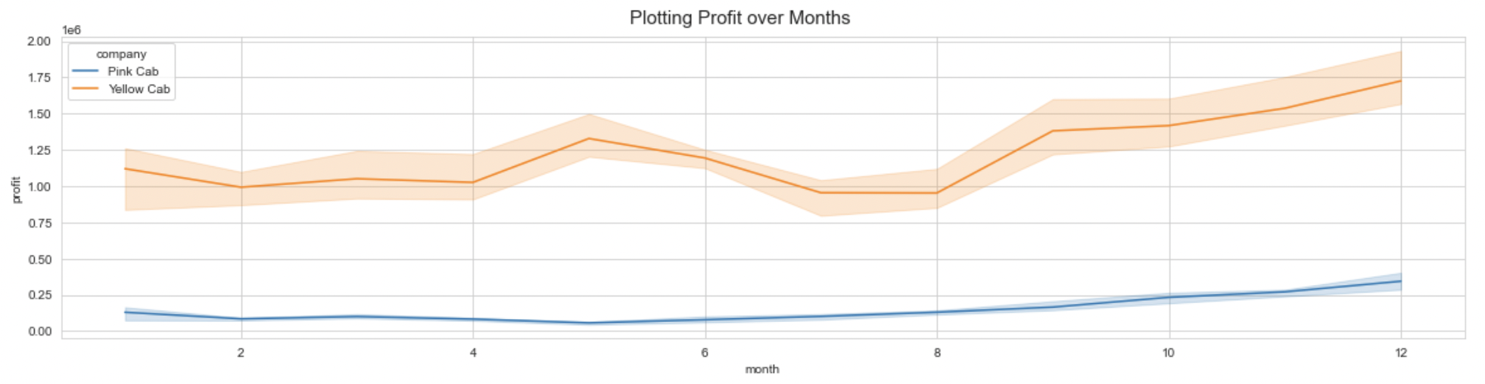
Profit Analysis by month
Ride counts are incresed between September and December, thus the profit is also increased for both companies, however Yellow cab clearly has majority of the rides and profit.

Slide 7
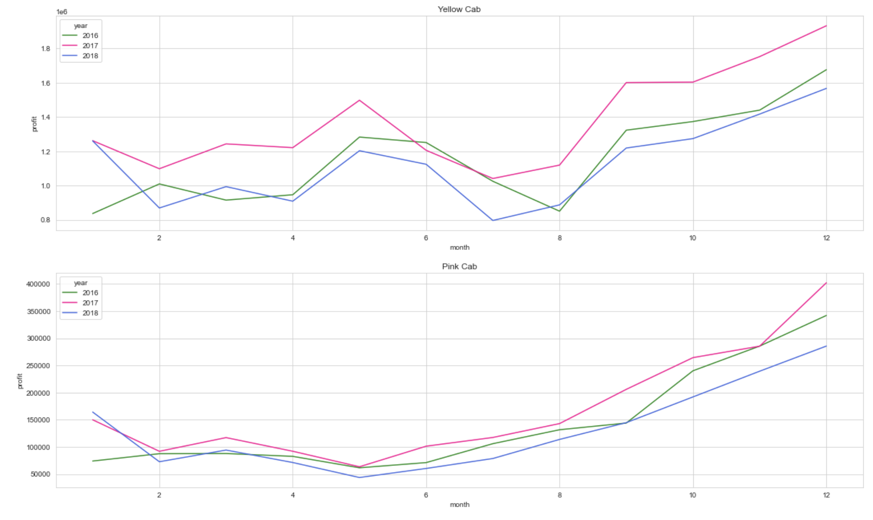
Profit Analysis over years
Both companies have made the most profit in year 2017 where Yellow cab has more profit than Pink Cab for every year.

Slide 8
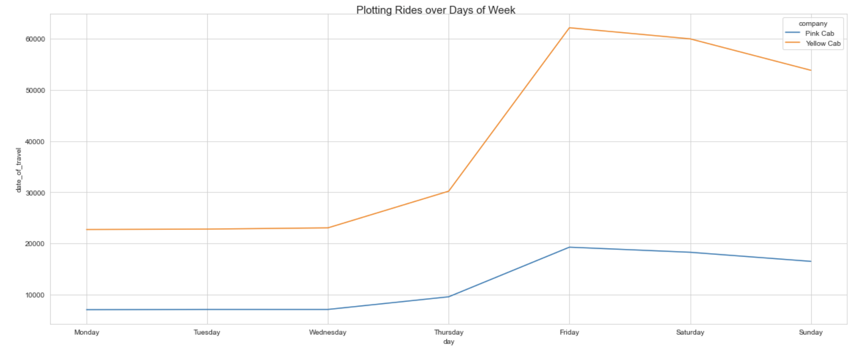
Ride Count by days of week
Both companies have more rides during weekends where it reaches the maximum on Fridays.

Slide 9
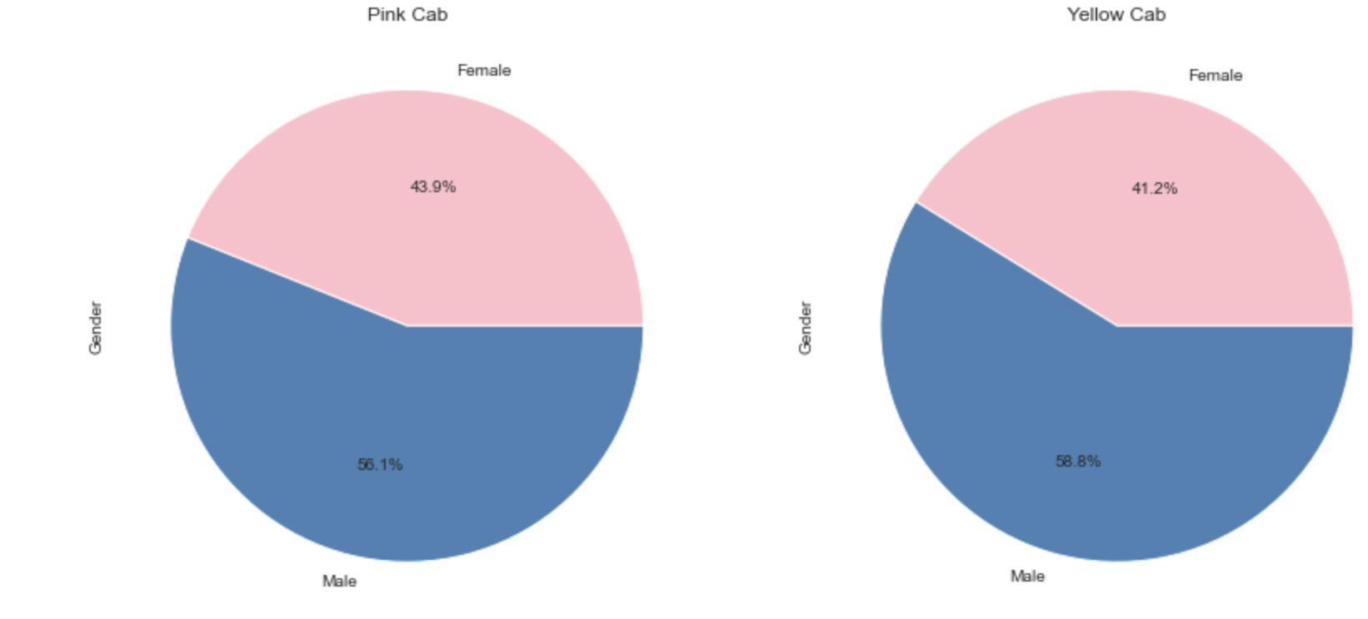
Profit Analysis by gender
Most cab users are male and represent 58% of users. The gender distribution is also the same for profit, there is no significant importance of gender on profit.

Slide 10
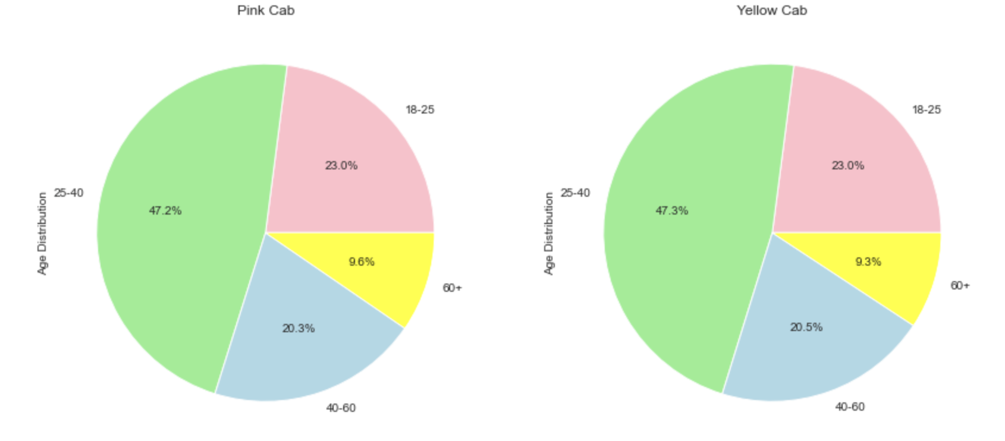
Profit Analysis by age
Majority of cab users are in 25-40 age group for both companies.

Slide 11
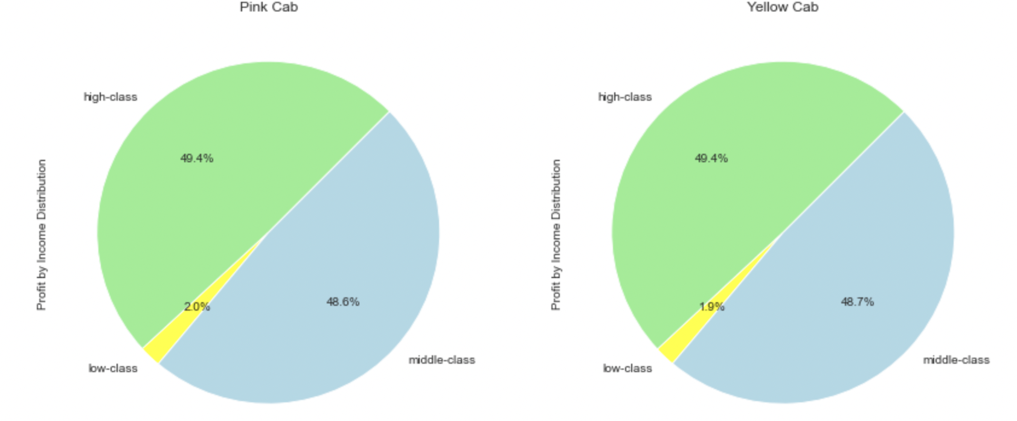
Profit Analysis by income group
Most of the users are in high and middle income groups.

Slide 12
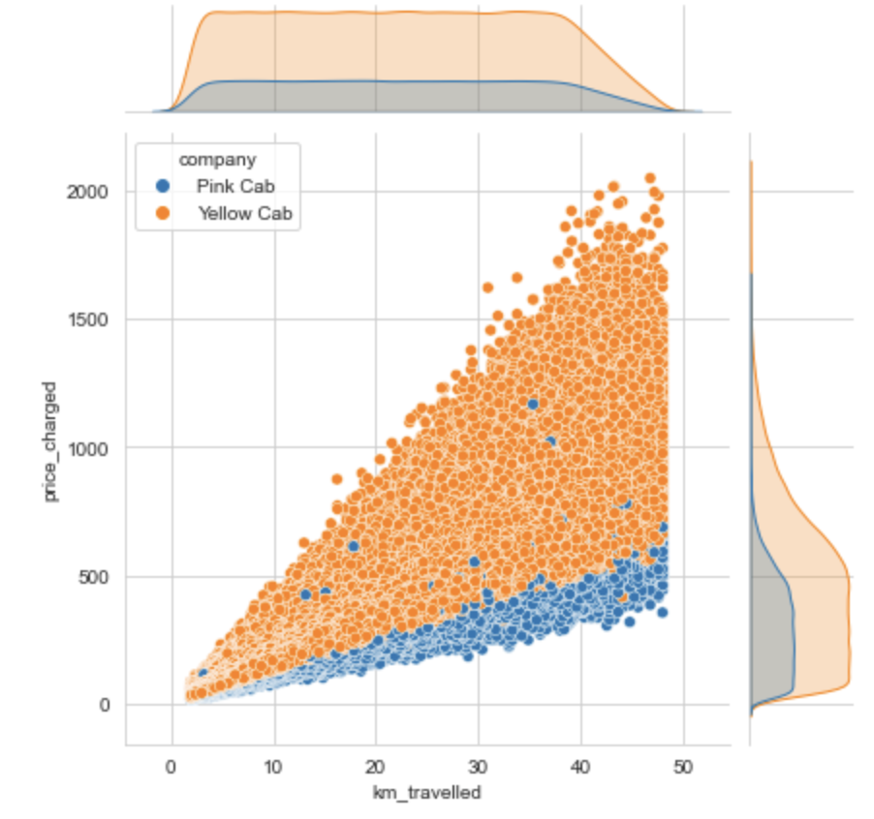
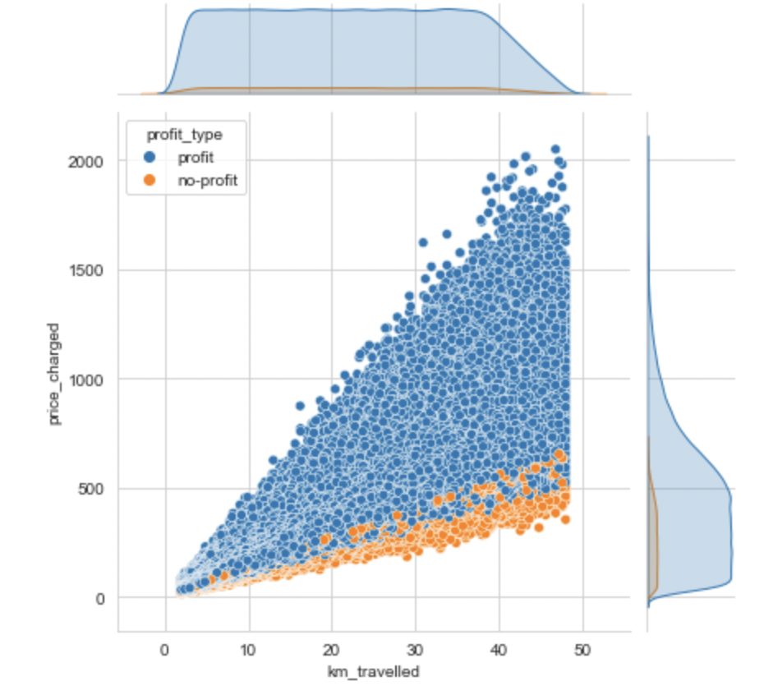
Profit Analysis by Price
Price has a significant effect on profit. Yellow cab charges much more than pink cab which has a positive effect on profit.

Slide 13
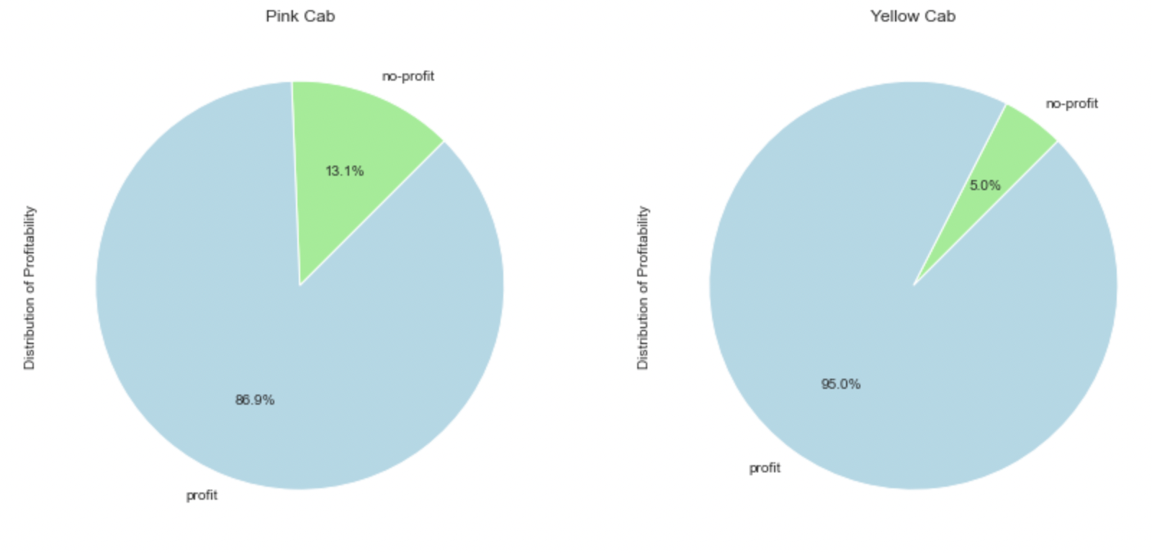
Profitability

Slide 14
Recommendations
Customer Reach: Yellow cab has higher customer reach in all the 20 cities. Yellow cab Company has more users in populated cities such as New York City.
Average Profit per KM: Yellow cab’s average profit per KM is almost three times the average profit per KM of the Pink cab.
Profitability: Yellow cab only has 5% non profit rides whereas Pink cab has almost 15%.
Price: The most significant reason for making profit is that the yellow cab charges nearly twice as much as the pink cab per km.
Having analyzed the data, we recommend the XYZ Company to invest in Yellow Cab.

Slide 15
Thank You

